Slide 1
Identifying Synthetic Content
MASTER SLIDE DECK
For presentation
English
Spanish with details
This master slide deck is NOT used for presentation.
Notes:
Start by creating a slide master that is in English. As needed duplicate and translate slides into target language. Color English slides in Yellow and target language slides in white. The example below uses Spanish as a theoretical target language.

Slide 2
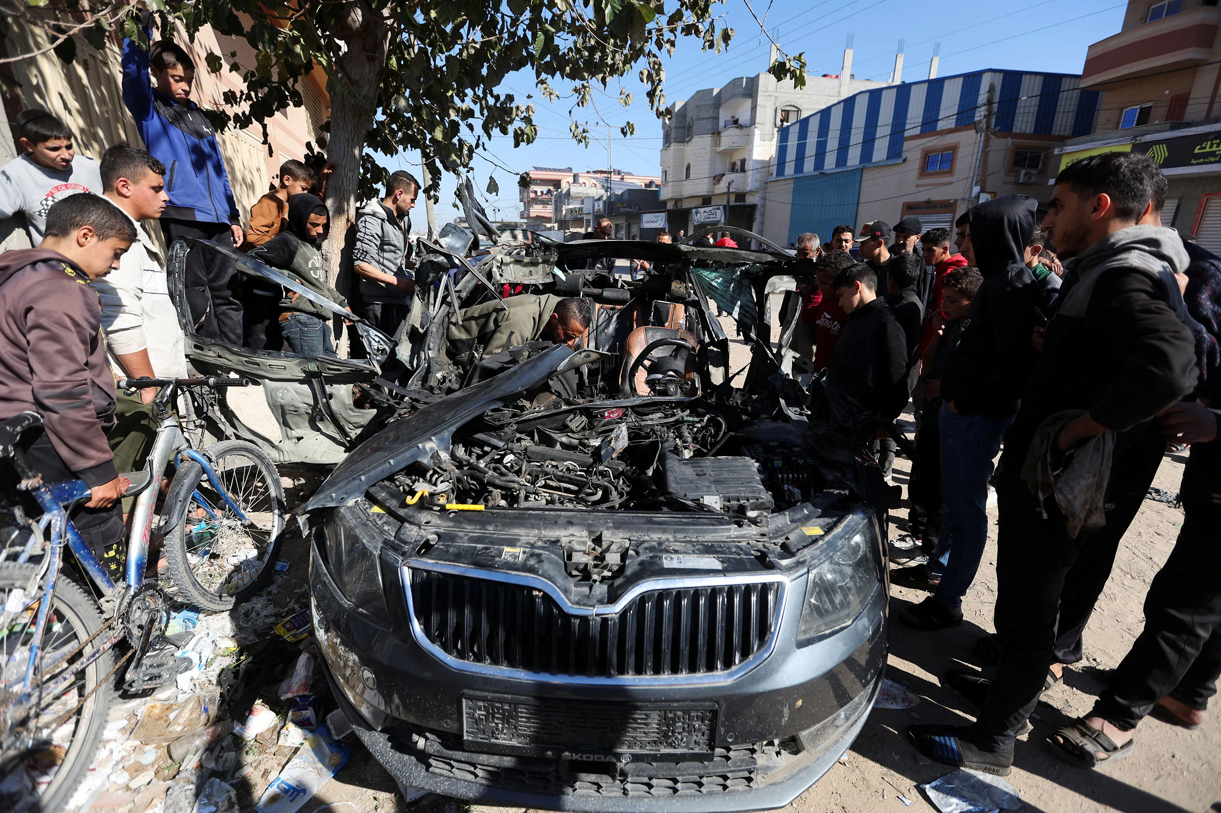
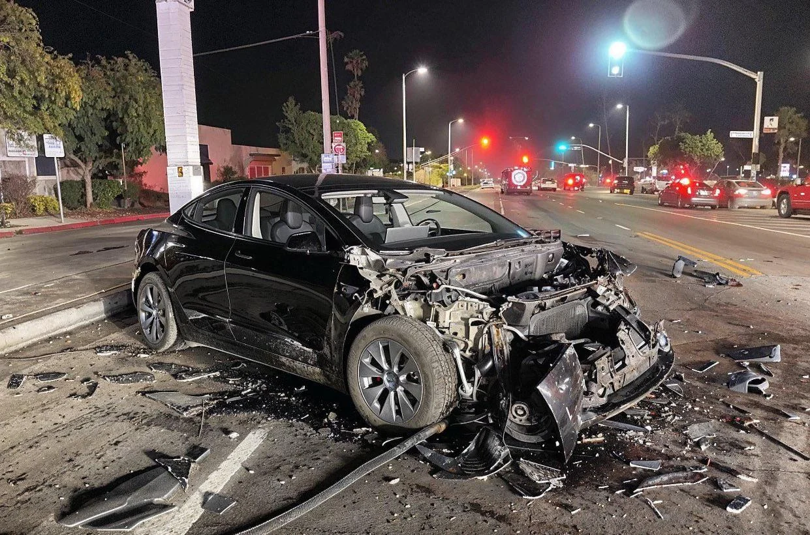
Which is Real?

Slide 3


Which is Real?

Slide 5
Identifying Synthetic Content
Notes:
Start by creating a slide master that is in English. As needed duplicate and translate slides into target language. Color English slides in Yellow and target language slides in white. The example below uses Spanish as a theoretical target language.

Slide 6
Lesson Objectives
Identify AI-generated content effectively using specific detection techniques for images, text, and audio.
References:
Media Lab at MIT on Detecting Fakes
Detect Fakes with Kellogg's online tool
CISA Contextualizing Deepfake Threats to Organizations
DARPA: Deepfake Defense Tech Ready for Commercialization, Transition

Slide 7
Human Image Check
Context of the scene
Hands and limbs of people
Face and facial features
Clothes and items

Slide 8
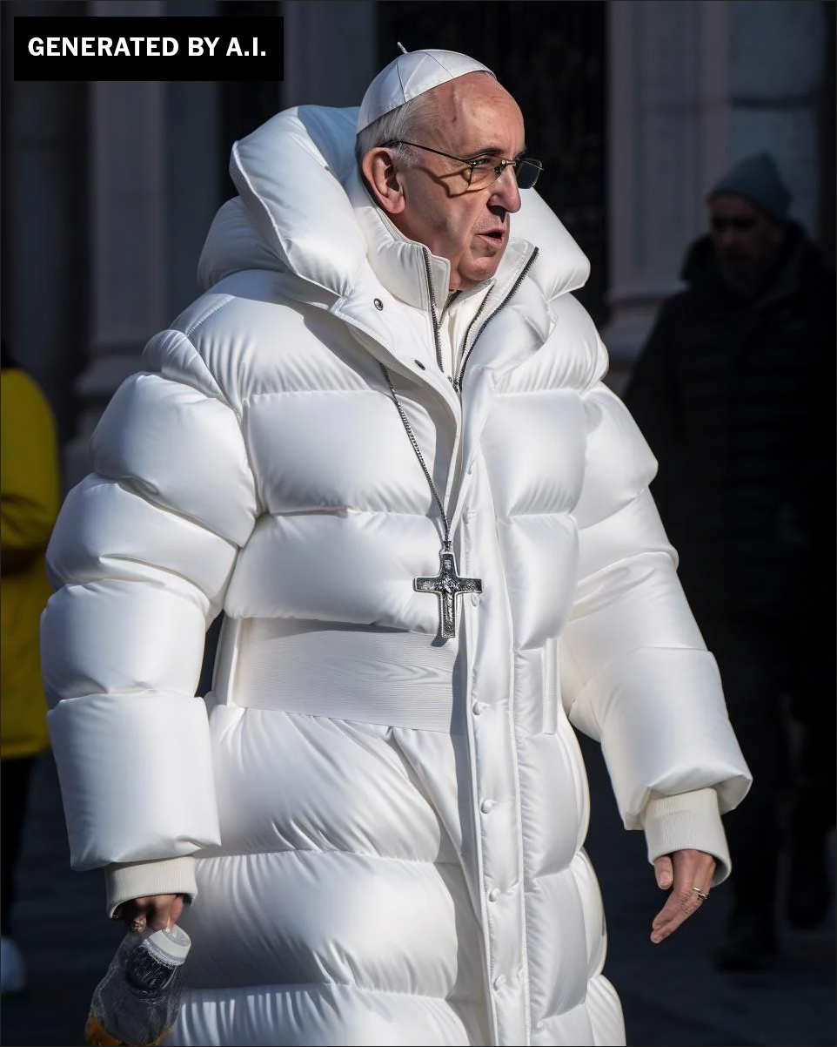
Human Images

Slide 9
Human Images: Context
Logic and Context of the Scene

Slide 10
Human Images: Hands and Limbs
Pay Attention to the Hands and Fingers

Slide 11
Human Images: Face
Pay Attention to the Face
Pay attention to the cheeks and forehead
Pay attention to the eyes and eyebrows
Pay attention to the glasses
Pay attention to facial hair
Pay attention to facial moles

Slide 12
Human Images: Clothing
Pay attention to the clothes
Warped Items
Missing and Extra items
Perspective and Geometry
Repetition in Detail
Material Texture

Slide 13
Human Image Check
Context of the scene
Hands and limbs of people
Face and facial features
Clothes and items

Slide 14
Human Image Check
Context of the scene
Hands and limbs of people
Face and facial features
Clothes and items

Slide 15

Human Images: Check On Learning
What do you notice?

Slide 16

Human Images: Check On Learning
What do you notice?

Slide 17
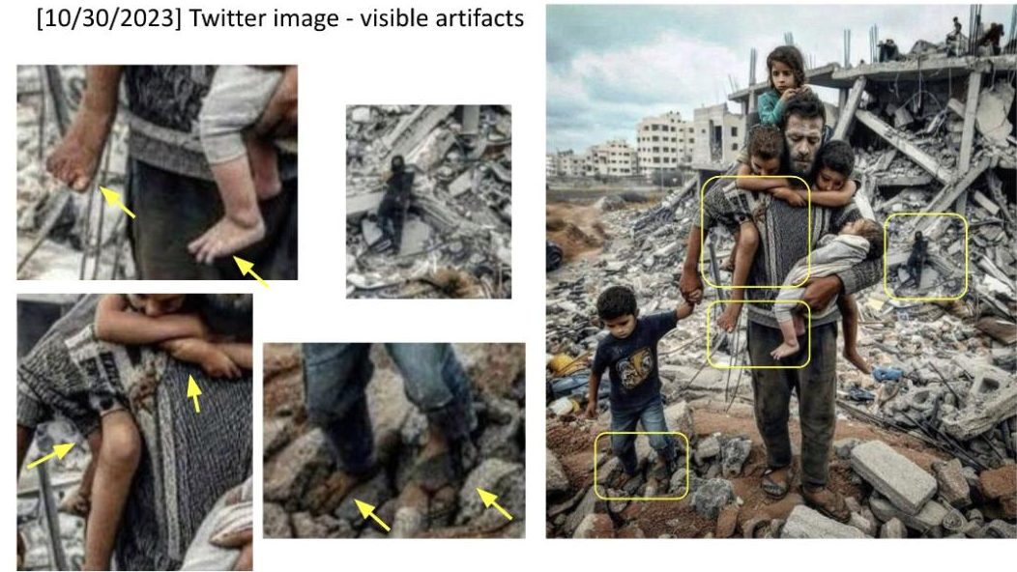

Slide 18
Structure Image Check
Context of the scene
Structural Consistency
Material Texture
Lighting and Shadows
Perspective and Geometry
Repetition in Detail
Missing Elements
Nonsensical Object Placement
Disrupted Continuity
Anomalies in Common Patterns

Slide 19
Structure Image: Check On Learning
Context of the scene
Structural Consistency
Material Texture
Lighting and Shadows
Perspective and Geometry
Repetition in Detail
Missing Elements
Nonsensical Object Placement
Disrupted Continuity
Anomalies in Common Patterns

Slide 20
Structure Image: Check On Learning
Context of the scene
Structural Consistency
Material Texture
Lighting and Shadows
Perspective and Geometry
Repetition in Detail
Missing Elements
Nonsensical Object Placement
Disrupted Continuity
Anomalies in Common Patterns

Slide 21
References
1. Media Lab at MIT on Detecting Fakes - https://www.media.mit.edu/projects/detect-fakes/overview/
2. Detect Fakes with Kellogg's online tool - https://detectfakes.kellogg.northwestern.edu/
3. CISA Contextualizing Deepfake Threats to Organizations - https://media.defense.gov/2023/Sep/12/2003298925/-1/-1/0/CSI-DEEPFAKE-THREATS.PDF
4. DARPA: Deepfake Defense Tech Ready for Commercialization, Transition - https://www.darpa.mil/news-events/2024-03-14#:~:text=Through%20the%20Semantic%20Forensics%20

Slide 22

Why Does It Matter To You?

Slide 23
¿Por Qué Te Importa?

Slide 24

TAKE A BREAK
Return By: XX:XX

Slide 25
TOMAR UN DESCANSO
Volver por: XX:XX

